Slide 1
Julius Bär
Team Jawab

Slide 2
Core Principles
Tractability
Explainability
Logical

Slide 3
Two-step approach
Filter clients - Remove some rejected clients
LLM - Inference on remaining clients

Slide 4
Flags
Pre-filtering process based on clear violations:
Missing important information
Inconsistent information
Likely to be based on real guidelines for JB staff
Eg. Address mismatch between client_profile and account_form

Slide 5
LLM inference
Inference executed after filtering
Uses Phi for reasoning
Check family background - Marital Status consistency and work history -

Slide 6
Training results
Confusion Matrix | Predicted Reject | Predicted Accept
Reject | 4234 | 5
Accept | 758 | 5003
-Accuracy 92.37%
-Precision 84.81%
-Recall 99.88%

Slide 7
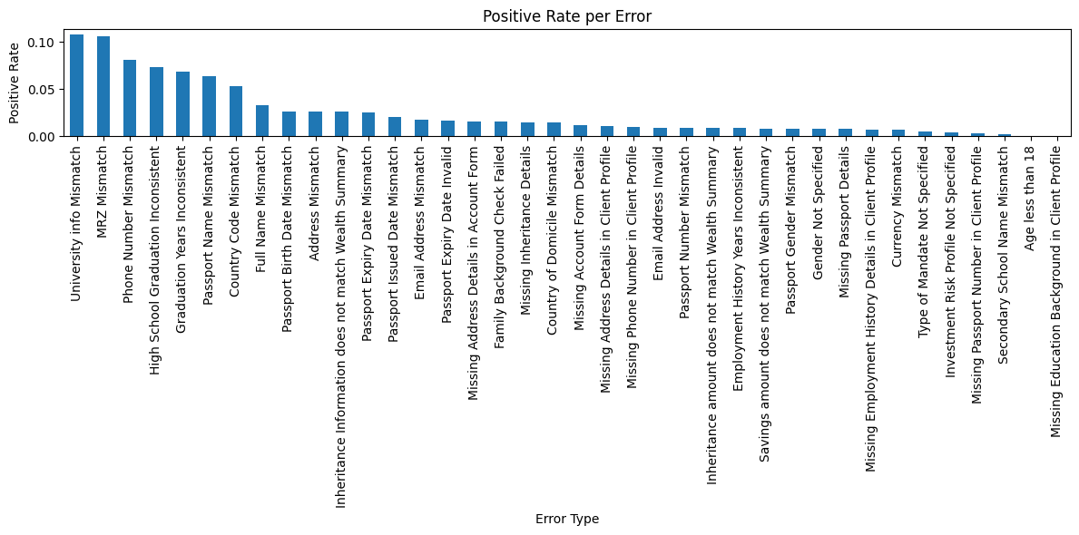
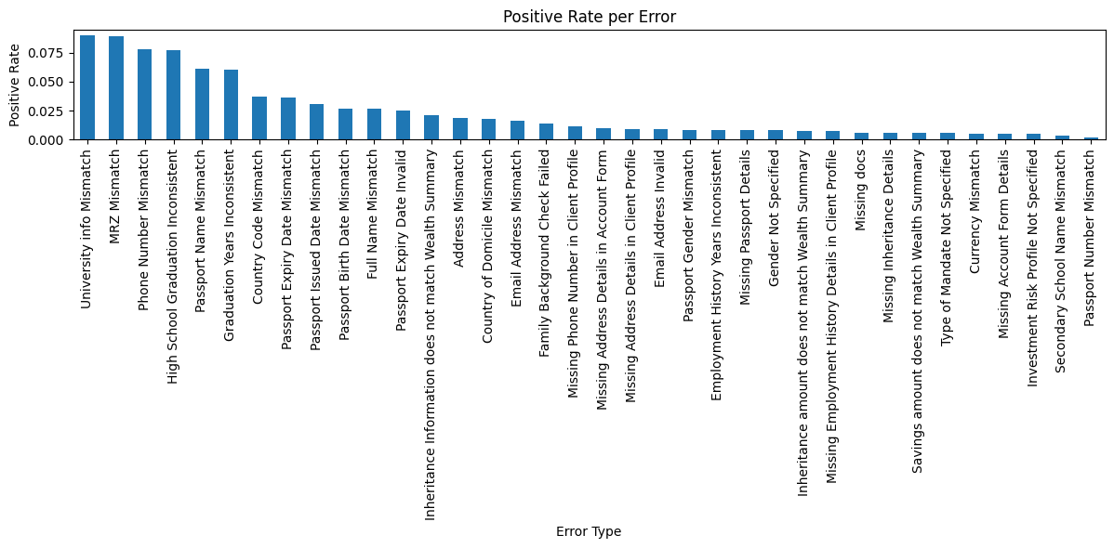
Interpretability Tracking
Output Dataframe with all the inconsistencies
Easy to check ALL the modification required per client !
Statistical Analysis of all the conflicting document for process optimization
Training (left) Validation (Right)

